Slide 1

Image recognition with
By free knowledge mission

Slide 2
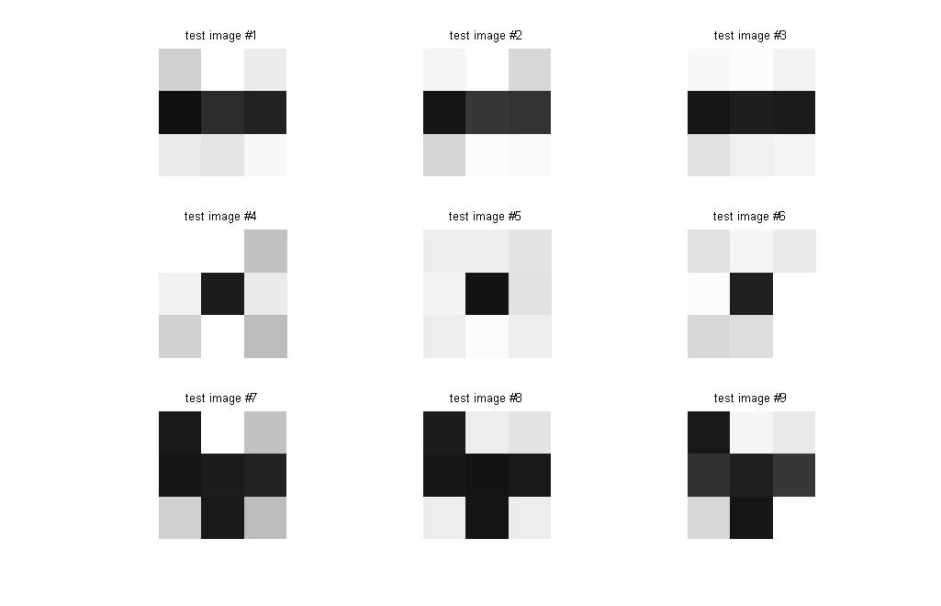
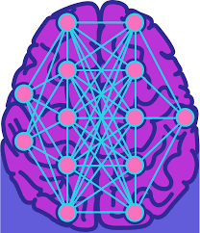
Computer Vision Methods
Pattern Recognition
Neural Networks

Slide 4


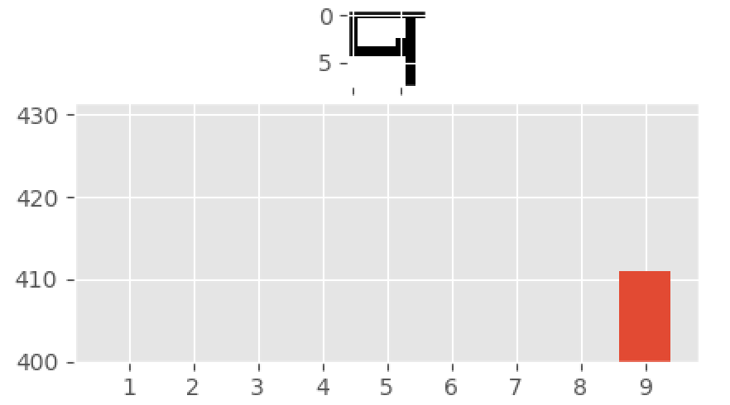
exercise Steps
Varied set of 100 numbers, 10 of each number
Let’s create a number in paint and compare to an dataset in an array
Will the computer know what number it is?
Develop Python Code
Run Matplotlib to graph the probability of the number drawn
I drew this number
Result

Slide 5
Prerequisites
Install Python from Python.org
Use Pip to install
Matplotlib
Numpy
Pillow or PIL(Python Image Library)
Download image files
Run code in Python IDLE

Slide 6
Just Show me the CodE ~ 100 lines

Slide 7
References
SENTDEX
Python Programming Code
Pattern Recognition Image
Neural Networks Image
Python Pillow Image

